Slide 1
Intro to Cryptography

Slide 2
Terminology
Cryptography – method of protecting information by encrypting plaintext messages into ciphertext and decrypting them using cryptographic algorithms
Cryptoanalysis – the process of recovering plaintext from ciphertext without the associated key
Cryptology – the mathematical study of the algorithms, formulas, and mathematical theory that underpin cryptography
Cipher – a cryptographic algorithm used to transform plaintext to ciphertext or vice versa
Plaintext – a message in clear text (i.e. human-readable)
Cipher text – a message that has been encrypted and is thus a stream of indecipherable bits
Key – A number, string, or sequence used in conjunction with a cryptographic algorithm to either encrypt plaintext or decrypt ciphertext

Slide 3
Encryption vs Hashing
Encryption
Two-way function: encrypted messages can be decrypted with the right key
Hashing
One-way function: transforms a plaintext message in an irreversible fashion to an indecipherable string
Although hashing is irreversible, some hashed passwords can still be compromised through comparison with hashes in rainbow tables
Rainbow tables are a collection of commonly used passwords passed through a hashing algorithm
A hash can be “salted” – a random number added to the password before hashing –to make it more difficult to identify a hashed password from a rainbow table
Often used for passwords
Hash collisions occur when two plaintext messages resolve to the same cryptographic hash with the same cipher

Slide 4
Popular Hashing Algorithms
MD5
Produces a 128-bit/16-byte hash value, often represented as a 32-digit hex number
Commonly used to check integrity of files
SHA
SHA-0, SHA-1, SHA-2, SHA-3
SHA-0 was replaced by SHA-1 due to an undisclosed critical flaw
SHA-1 is the most commonly used of the three, and creates a 20-byte hash
SHA-2 is the strongest of the three, and creates a 32-byte hash
Consists of six variants, SHA-224, SHA-256, SHA-384, SHA-512, SHA-512/224, SHA-512/256
SHA-3 differs from the other SHA implementations, which are similar to MD5, as it is a member of the Keccak crypto family

Slide 5
Symmetric Key Cryptography
Also known as Private Key Cryptography
The sender and the receiver use the same key to encrypt plaintext and decrypt cipher text
Includes:
Most classical ciphers
Substitution ciphers
Transposition ciphers
AES
DES

Slide 6
Classic Ciphers
Some famous classical ciphers include:
Caesar cipher
Atbash cipher
Rail cipher
Baconian cipher
Affine cipher
Polybius cipher
Vigenere cipher
Playfair cipher
Hill cipher

Slide 7
Advanced Encryption Standard (AES)
Most popular symmetric key algorithm
More secure (and computationally faster) than DES and 3DES due to a more robust algorithm and longer key length
Consists of three block ciphers, AES-128, AES-192, AES-256
Encrypts/decrypts data in 128-bit block
AES Encryption:
Substitute data with a substitution table
Shift data rows
Mix columns
Exclusive or on each column

Slide 8
Advanced Encryption Standard (AES)
Source: https://searchsecurity.techtarget.com/definition/Advanced-Encryption-Standard

Slide 9
Data Encryption Standard (DES)
Block cipher that encrypts data in 64-bit blocks
Each block is split into L and R blocks in encryption
An initial 64-bit key is transformed to a 56-bit key before encryption by discarding every 8th bit
Replaced by AES
Commonly used with one of three modes: ECB, CBC, CFB

Slide 10
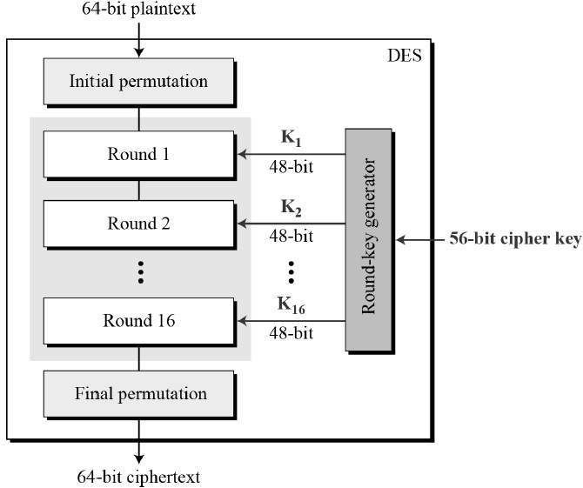
Data Encryption Standard (DES)
Source: https://www.tutorialspoint.com/cryptography/data_encryption_standard.htm

Slide 11
Asymmetric Key Cryptography
Also known as Public Key Cryptography
Decryption key is different from encryption key, and cannot be determined easily from the other
The encryption key, or public key, can be announced publically and can be used by anyone to encrypt messages that only a receiver with a private decryption key can decrypt
Security based on computational difficulty of certain problems
Examples:
Diffie-Hellman
RSA
PGP

Slide 12
Diffie-Hellman
Secure public key algorithm
Algorithm steps:
Alice and Bob agree on a prime number p and base g
Alice chooses a secret number a, and sends Bob the value of g^a mod p
Bob chooses a secret number b, and sends Alice the value of g^b mod p
Alice computes ((g^b mod p)^a mod p)
Bob computes ((g^a mod p)^b mod p)
The values of p and g must be protected

Slide 13
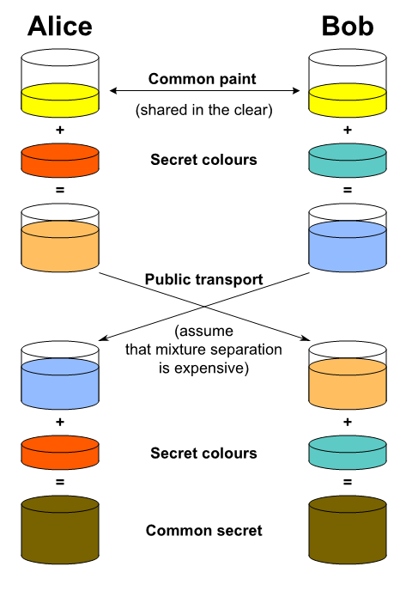
https://www.codeproject.com/Articles/1219531/Implement-Diffie-Hellman-in-Csharp?msg=5464086

Slide 14
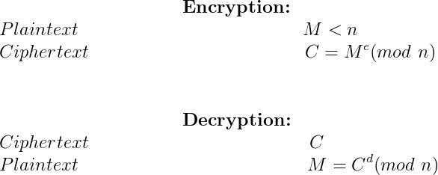
RSA
Public key includes two numbers, one of which is the multiplication of two large prime numbers
Private key derived from same two large prime numbers
Encryption strength relies on key size – the more bits in public key, the harder it is to factor into the two primes
Source: https://www.geeksforgeeks.org/rsa-algorithm-using-multiple-precision-arithmetic-library/

Slide 15
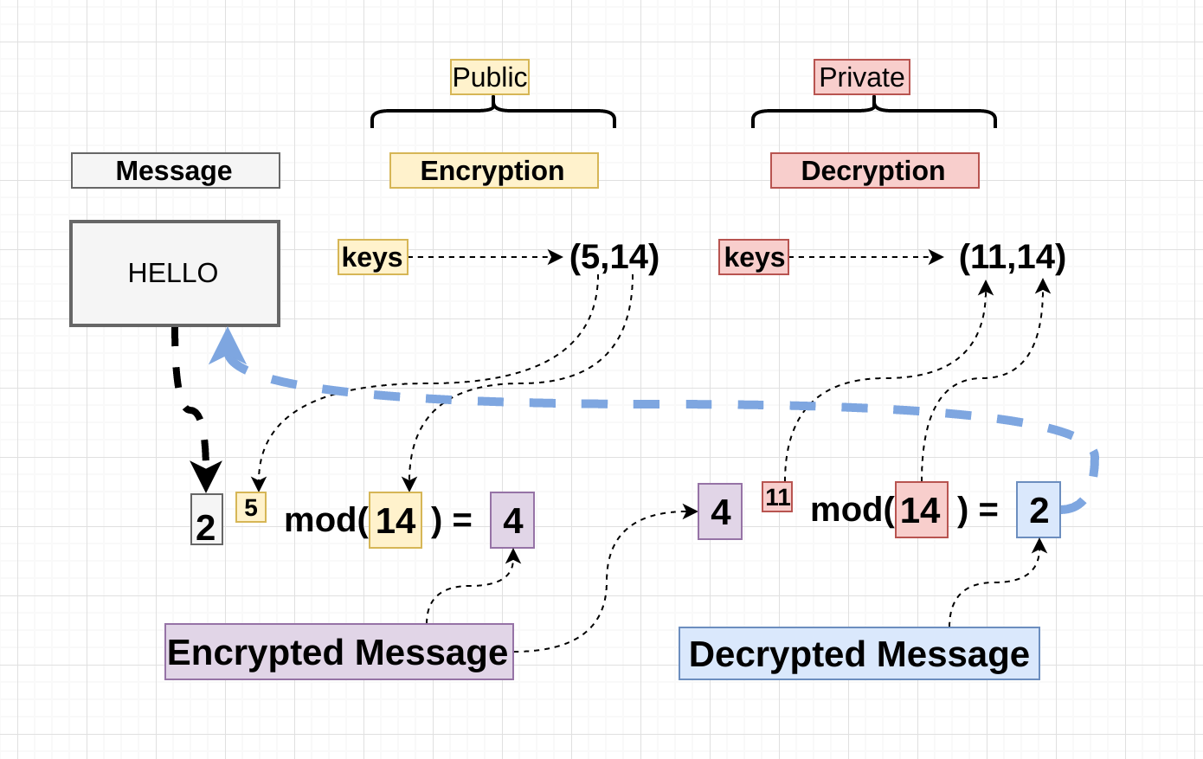
https://hackernoon.com/how-does-rsa-work-f44918df914b

Slide 16
Crypto in CTFs
Most crypto problems in CTFs revolve around AES, RSA, or a custom implementation of an encryption algorithm
Often requires writing a script to decrypt provided ciphertext to a plaintext flag
Useful tools:
Python
Quipqiup (best used for classical ciphers)
Dcode
Has a variety of solvers for classical ciphers
Frequency analysis tool can be used to decipher custom substitution schemes

