Slide 1
Steganography

Slide 2
What is Steganography?
Steganography is the technique of concealing secret information or data within an ordinary file or message to avoid detection
Similar to cryptography, the goal of steganography is to deliver a message that can only be extracted and read by the intended recipient
Often, the two techniques are used in conjunction where data is first encrypted with a cryptographic scheme and then steganographically-hidden

Slide 3
Terminology
Covertext/cover image: The medium in which a hidden message is embedded
Steganalysis: study of detecting messages hidden using steganography

Slide 4
Types of Steganography
Image-based – hidden data is embedded within an image in a way that is not easily visible
LSB or MSB data insertion
Discrete Cosine Transform algorithm
Append algorithm/manipulation of exif metadata
Video-based – individual frames of the video are extracted, modified, and reinserted to hide data
Audio-based – image data is encoded into a waveform using a program like COAGULA

Slide 5
Least Significant Bit (LSB) Insertion
Operates by embedding hidden data into an image by replacing the least significant bit of a pixel’s RGB value
The least significant bit has the smallest visible effect on the photo when manipulated, rather than the most significant bit

Slide 6
LSB Example
We want to hide the string: “SOS” within an image.
In binary, the string is:
01010011 01001111 01010011
We will be modifying 24 bits to hide this message, and thus need 24 pixels.

Slide 7
Original image

Slide 8
LSB Insertion
We begin inserting our string by changing the LSB of each pixel

Slide 9
Modified Image

Slide 10
Decrypting
The text can be retrieved by decrypting the cover image, given the steganography algorithm

Slide 11
Discrete Cosine Transform
Involves the transformation of a signal or image from the spatial domain to the frequency domain, allowing for the separation into high, middle, and low frequency planes
Harder to detect than LSB

Slide 12
Append algorithms
Appends data as padding in the image
Visibly hidden, but can easily be detected when viewed with a hex editor

Slide 13
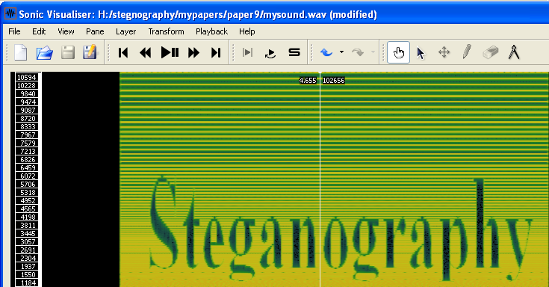
Audio Steganography
Messages can be hidden in audio by manipulating the spectogram of a given audio file, resulting in a visible message that is only detected by individuals looking at the spectogram directly.
Source:
Comparative study of Steganography on Gray, Indexed, Colour and Black & White images by Equal / Near Equal Value Pixel Replacement Point Operations -- Rizwan Usman

Slide 14
Sample Steganalysis Tools
https://github.com/DominicBreuker/stego-toolkit
Some tools include:
Stegsolve
File
Ffmpeg
Stegbreak
Zsteg
Identify
Audacity (audio)

