Slide 1
Cyber Operation and Penetration Testing Scanning Cliff Zou University of Central Florida

Slide 2
Acknowledgement
Content from the book:
“The Basics of Hacking and Penetration Testing: Ethical Hacking and Penetration Testing Made Easy”, Second Edition

Slide 3
Acknowledgement
Presentation slides:
“Using Nessus and Nmap to Audit Large Networks”
By Greg Johnson, Principal Security Analyst University of Missouri – Columbia
https://www.cs.uaf.edu/2003/fall/cs493/refs/JohnsonAudit.ppt

Slide 4
Checking Machine Online Status?
root@kali: ping IPaddress
Windows with firewall enabled blocks PING by default for not home network (subnet)
Enable PING response in Windows:
Search “firewall”, click “Windows Firewall” in control panel
Click “Advanced settings” on the left
From the left panel, click “Inbound Rules”
Find the rules titled “File and Printer Sharing (Echo Request - ICMPv4-In)”
Right-click each rule and choose “Enable Rule”.

Slide 5
Ping and Ping Sweep
Ping Sweep: series of pings sent to a range of IP addresses
Tool: fping (preinstalled in Kali Linux)
fping -a -r 0 -g 192.168.0.1 192.168.0.254
-a: only show live
-r 0: retry ping number (0 means only 1 ping per IP)
-g: the IP range
Con: only can find computers that respond to ICMP echo request message

Slide 6
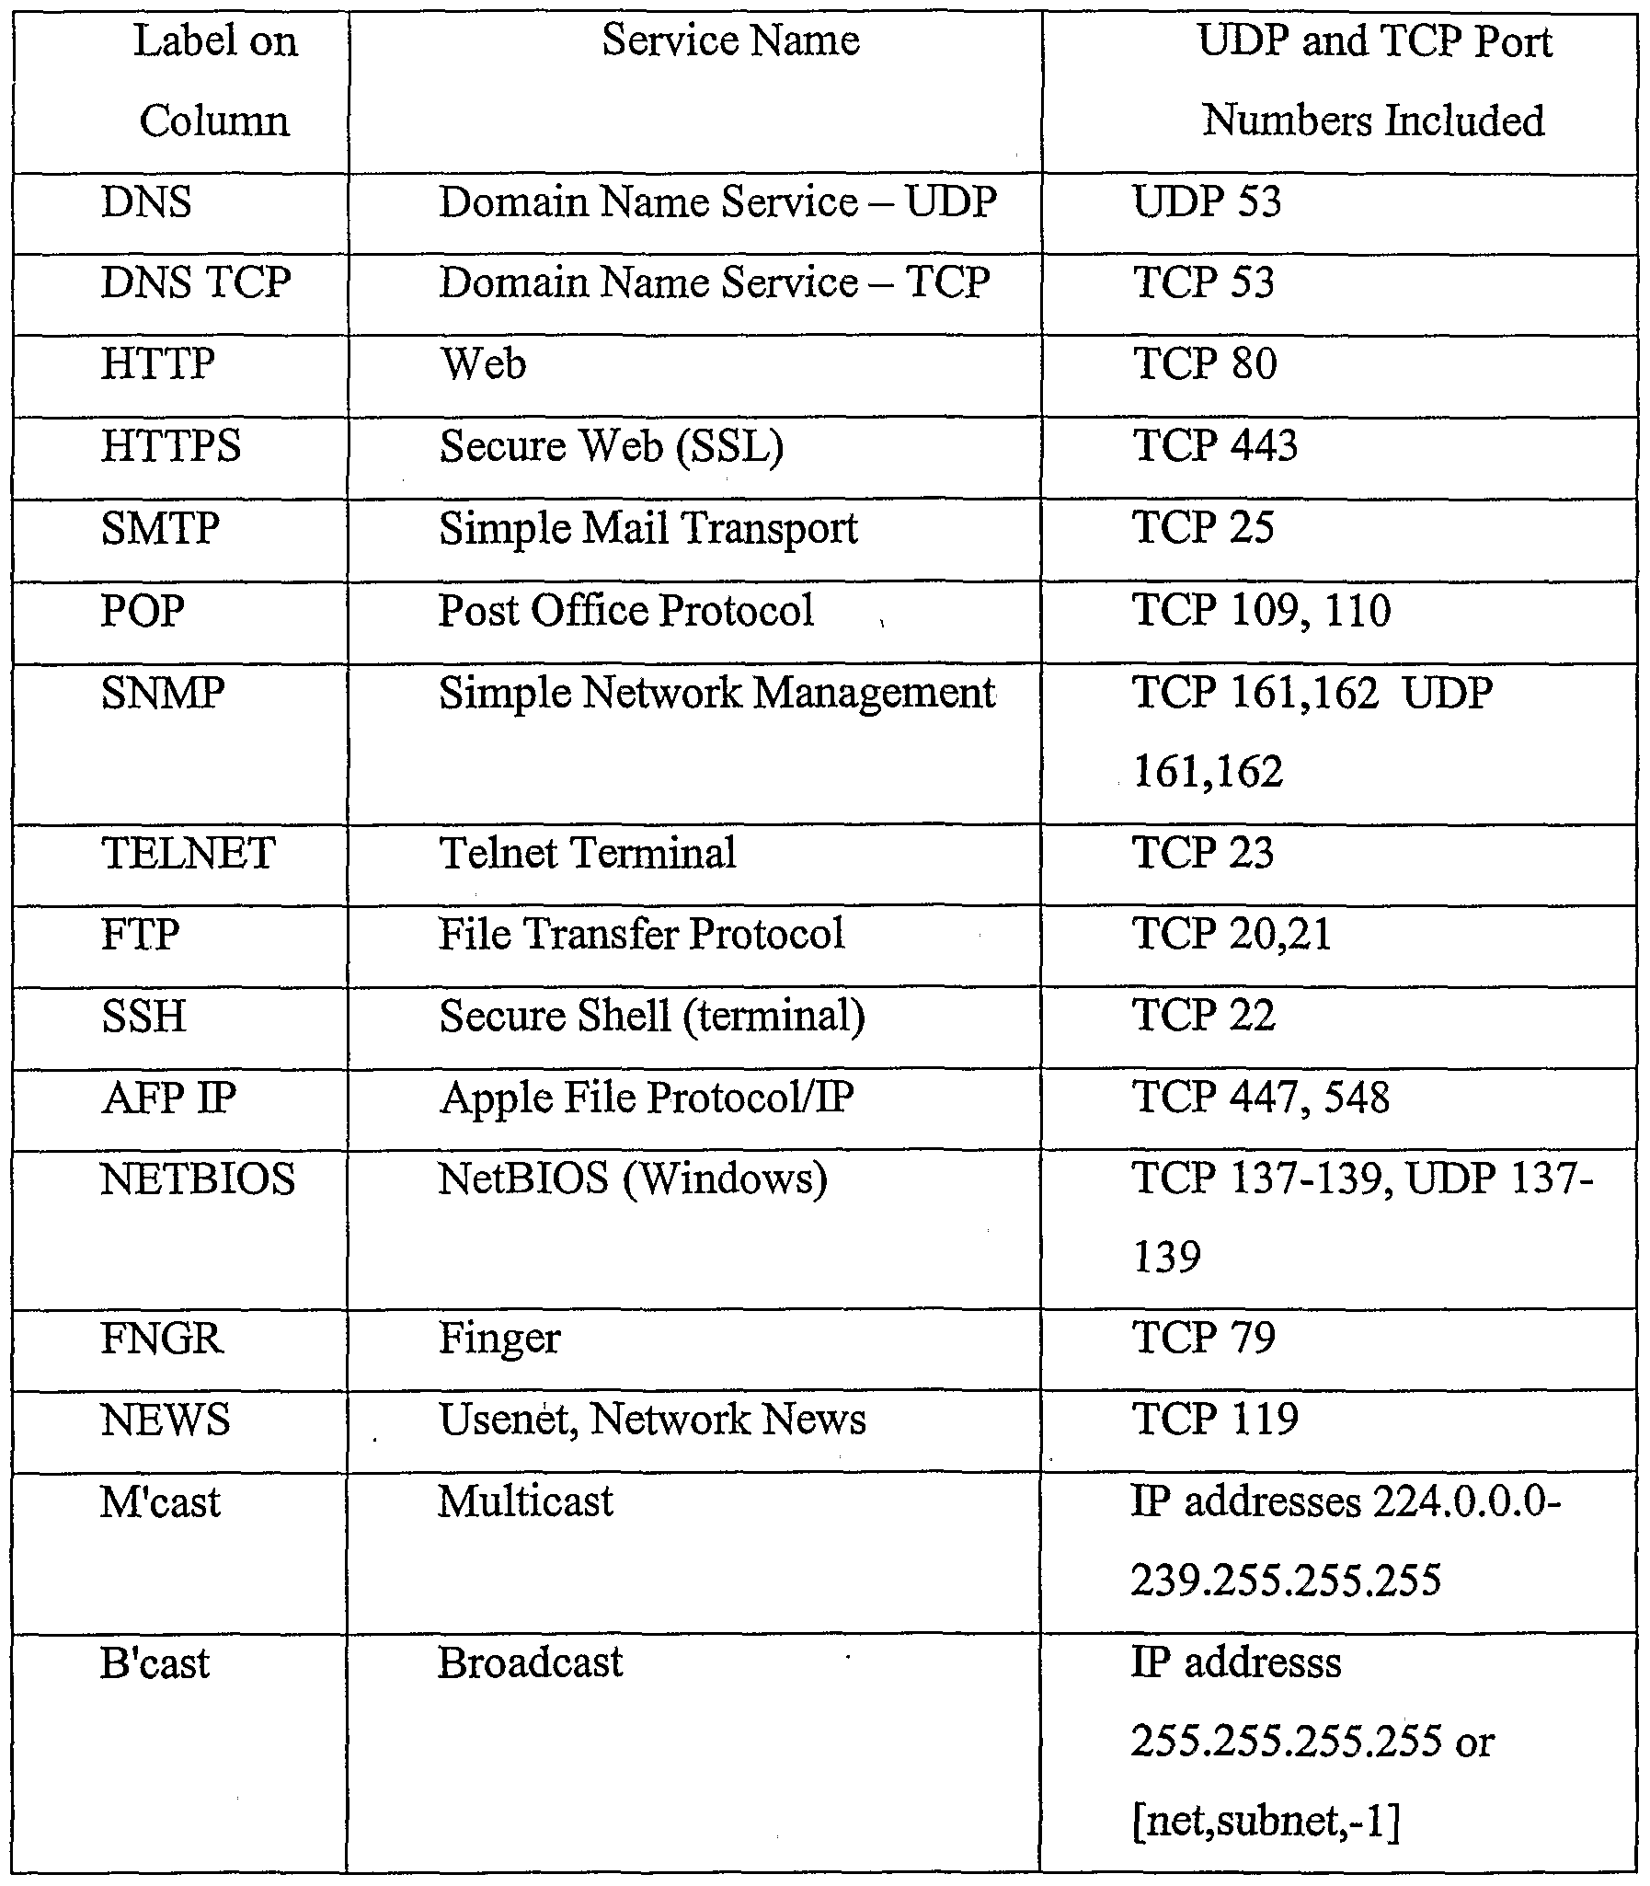
Port Scanning
Discover what services are running on a target computer
See the “common port number” sheet: http://packetlife.net/media/library/23/common_ports.pdf

Slide 7
Pre-Knowledge: Network Layered Structure
What is the Internet?
Application
Web, Email, VOIP
Application
Transport
TCP, UDP
Transport
Network
IP
Network
Data Link
Ethernet, cellular
Data Link
Physical link

Slide 8
Pre-Knowledge: TCP segment structure
32 bits
URG: urgent data
(generally not used)
counting
by bytes
of data
(not segments!)
source port #
dest port #
sequence number
ACK: ACK #
valid
acknowledgement number
head
len
not
used
U
Receive window
A
P
R
S
F
PSH: push data now
# bytes
rcvr willing
to accept
checksum
Urg data pnter
RST, SYN, FIN:
connection estab
(setup, teardown
commands)
Options (variable length)
application
data
(variable length)
Internet
checksum
(as in UDP)

Slide 9
TCP Connection Setup --- Three-Way Handshaking
Step 1: client host sends TCP SYN segment to server
specifies initial seq #
no data
Step 2: server host receives SYN, replies with SYN/ACK segment
server allocates buffers
specifies server initial seq. #
Step 3: client receives SYN/ACK, replies with ACK segment, which may contain data
client
server
SYN,
seq=client_seq
SYN/ACK,
seq=server_seq, ack=client_seq+1
ACK,
seq=client_seq+1
ack=server_seq+1

Slide 10
TCP Connection Management (cont.)
Closing a connection:
close();
Step 1: client end system sends TCP/FIN control segment to server
Step 2: server receives FIN, replies with ACK. Closes connection, sends FIN.
client
server
close
FIN
ACK
close
FIN
ACK
timed wait
closed

Slide 11
TCP Connection Management (cont.)
Step 3: client receives FIN, replies with ACK.
Enters “timed wait” - will respond with ACK to received FINs
Step 4: server, receives ACK. Connection closed.
client
server
closing
FIN
ACK
closing
FIN
ACK
Some applications simply send RST to terminate TCP connections immediately
timed wait
closed
closed

Slide 12
Private IP subnets used in NAT
10.0.0.0/8
UCF using this large subnet
Many global IPs ←→ this 2²⁴ IP space
192.168.0.0/16
Home WiFi and Wifi hotspot use this subnet
Home Wifi uses 192.168.0.0/24, or 192.168.1.0/24
Single global IP ←→ this 256 IP space
172.16.0.0/12
Not widely used

Slide 13
TCP based Scan
TCP connect scan
Open port: syn/ack response
Closed port: rst/ack response
TCP syn scan (half-open scan)
TCP fin scan
TCP null scan (no flag is set)
TCP ack scan
TCP XMAS tree scan (all flags are set)

Slide 14
Background: Port Status
A port can be:
Closed (not in use),
Open (listening), or
Filtered (the client computer asked for open or closed status report, and the target computer did not reply, usually due to a firewall.)

Slide 15
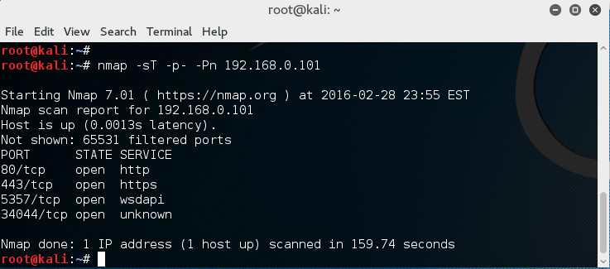
Port Scanning Tool: Nmap
Included in Kali Linux
nmap –sT 192.168.0.101
Default scan will scan 1000 TCP ports
For safety, try nmap on your own VMs in the same LAN, such as the Metasploitable VM

Slide 16
Nmap Command Options
-sT: TCP connect scan
-sS: TCP SYN scan
-sA: TCP ACK scan
-sF: TCP FIN scan
-sX: XMAS tree scan
-sN: NULL scan
-sP: Ping scan
-sU: UDP scan
-sO: protocol scan
A good online tutorial:
https://hackertarget.com/nmap-cheatsheet-a-quick-reference-guide/

Slide 17
Nmap Target Selection
Scan a single IP
nmap 192.168.1.1
Scan a host
nmap www.testhostname.com
Scan a range of IPs
nmap 192.168.1.1-20
Scan a subnet
nmap 192.168.1.0/24
Scan targets from a text file
nmap -iL list-of-ips.txt (one IP per line)

Slide 18
Nmap Port Selection
Scan a single Port
nmap -p 22 192.168.1.1
Scan a range of ports
nmap -p 1-100 192.168.1.1
Scan 100 most common ports (Fast)
nmap -F 192.168.1.1
Scan all 65535 ports
nmap -p- 192.168.1.1
Be careful with this. Generate large amount of scanning traffic!

Slide 19
Nmap Port Scan Types
Scan using TCP connect
nmap -sT 192.168.1.1
Scan using TCP SYN scan (default)
nmap -sS 192.168.1.1
Scan UDP ports
nmap -sU -p 123,161,162 192.168.1.1
Scan selected ports - ignore discovery
nmap -Pn -F 192.168.1.1

Slide 20
What NMAP Does Not Do
NMAP does not determine what program is running at an open port! Whatever service NMAP reports—http, ftp, smtp, etc.—is an assumption based on standards.
Hacker trick: disguise a remote control access with the port number normally used by domain name service (53), web service (80), etc. especially if firewalls pass traffic on these ports.

Slide 21
Service and OS Detection
Detect OS and Services
nmap -A 192.168.1.1
Will setup connection successfully and get the first data packet from the server
Standard service detection
nmap -sV 192.168.1.1
More aggressive Service Detection
nmap -sV --version-intensity 5 192.168.1.1
Lighter banner grabbing detection
nmap -sV --version-intensity 0 192.168.1.1

Slide 22
Service and OS Detection
The more aggressive service detection is often helpful if there are services running on unusual ports.
The lighter version of the service will be much faster as it does not really attempt to detect the service by simply grabbing the banner of the open service.

Slide 23
Nmap Script Engine (NSE)
Nmap --script banner 192.168.0.101
Setup TCP connection, get the first response text from the target
Nmap --script vuln 192.168.0.101
Run a series of scripts looking for known vulnerabilities

Slide 24
GUI-based Nmap: Zenmap
Included in Kali Linux
Where?
Application menu → “Information Gathering…” → Zenmap
You can download Zenmap for Windows and Mac OS as well
https://nmap.org/zenmap/

Slide 25
Nessus: a GUI-based Power Network Scanner
Nessus is a proprietary vulnerability scanner which is developed by Tenable Network Security. It is free of charge for personal use in a non-enterprise environment ----wikipiedia.com
Download home-only FREE version: http://www.tenable.com/products/nessus/select-your-operating-system
Request a home-only registration key: http://www.tenable.com/products/nessus-home
Tutorial on installing nessus on Kali Linux
http://www.tenable.com/blog/installing-and-using-nessus-on-kali-linux

Slide 26
Install Nessus on Kali Linux
Download the free home version of nessus for Linux:
Debian 6 and 7 / Kali Linux 1 AMD64 (64bit VM)
File: Nessus-6.5.6-debian6_amd64.deb
Debian 6 and 7 / Kali Linux 1 i386 (32-bit VM)
File: Nessus-6.5.6-debian6_i386.deb

Slide 27
Install Nessus on Kali Linux
#dpkg –i Nessus-6.5.6-debian6_amd64.deb
For programs existed in Kali’s App store, use “apt-get install …” to install them
Enable nessus service first:
#/etc/init.d/nessusd start
Then the nessus demon will start to run
Nessus relies on Web Browser for GUI and remote access
Local access: https://localhost:8834/
Remote access: https://192.168.0.3:8834/ (if the machine running nessusd has IP of 192.168.0.3)

Slide 28
Web Browser-based GUI and Remote Access
Many recent software use this way for implementation
Pros:
A user can remote access and use the software
Remote user does not need any client-side software installation
Cons:
Rely on the graphic and interaction functions provided by Browsers, may not be beautiful
Could suffer the same Web-based attacks

Slide 29
Use of Nessus
Why Nessus runs as a webserver (on port 8834)?
It enables other computers to do nessus scanning, too, by remote login to the Nessus server machine
You can install Nessus server on Linux, or Windows
Nice video tutorial on using Nessus:
https://www.youtube.com/watch?v=r_pDVhNoYr0

Slide 30
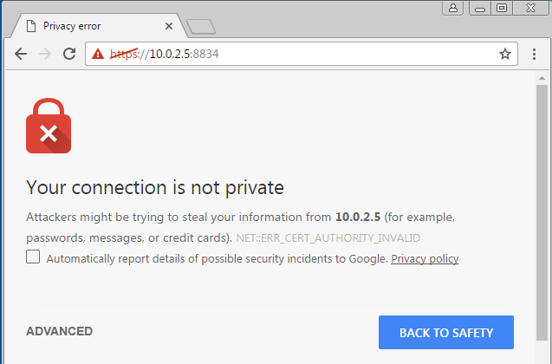
Use of Nessus
Assume the Nessus is installed in Kali VM
We run Nessus on the Win7 VM in the same LAN
The warning is normal
Due to the Nessus
Server has no valid
Digital certificate

Slide 31
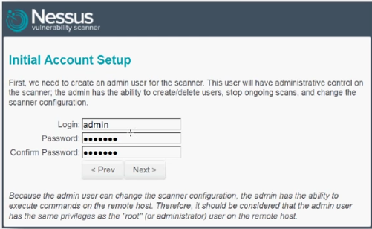
Use of Nessus
First run, set up an account as you choose the username and password

Slide 32
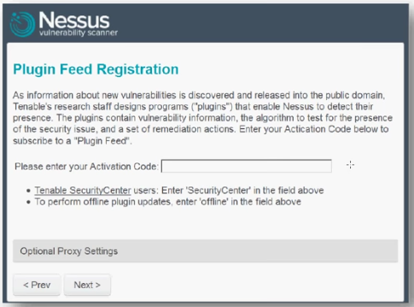
Use of Nessus
First run, after account set up, you need to input your activation code:

Slide 33
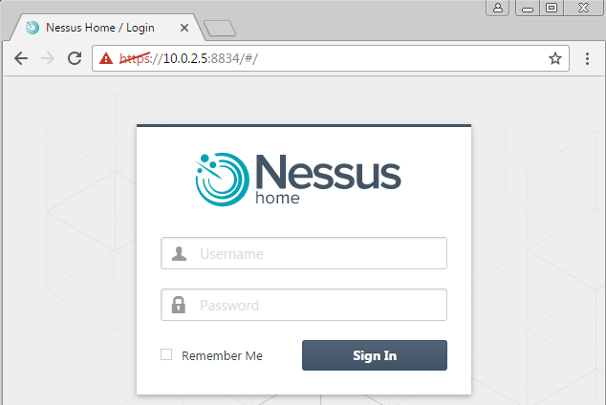
Use of Nessus

Slide 34
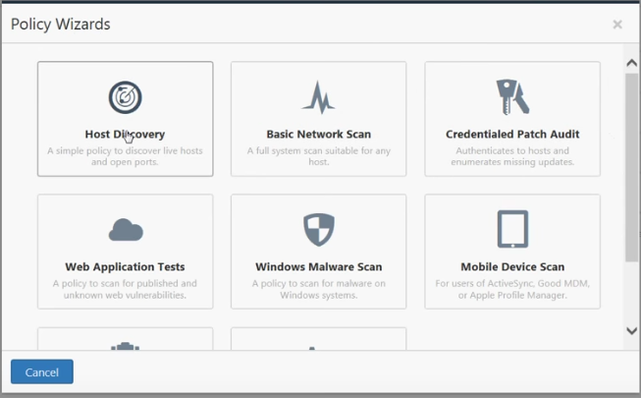
Use of Nessus
The free version comes with a few predefined types of scans
The gray entries are only available in commercial version

Slide 35
Use of Nessus
Test of Basic Network Scan:
You can test to scan your Kali VM, Win7 VM,
The best target is the Metasploitable VM since it has many vulnerabilities that can be discovered by Nessus

Slide 36
Metasploitable 2 Virtual Machine
Use nmap to see what services are running on this Linux
Use Nessus installed on your Kali Linux to check any known vulnerabilities on this Linux

Slide 37
Is Scanning Dangerous?
Both NMAP and NESSUS aim to never damage data.
In MU’s NMAP and NESSUS scanning of 13,000 connections in its network, no data has ever been lost through scanning.

Slide 38
Is Scanning Dangerous?
HOWEVER!
NMAP and especially NESSUS can freeze scanning targets. The network application may freeze. The entire system may require restarting. Some devices such as printers or routers may reset themselves—or not.

Slide 39
Is Scanning Dangerous?
In MU’s scanning, freezes are rare: about one in six hundred general purpose systems for tests that are not explicitly dangerous.
NESSUS designates about 10% of its tests as dangerous, denial of service attacks such as oversize data or flooding. In tests of 200 diverse systems, around one third eventually fell to a denial of service attack.

Slide 40
Is Scanning Dangerous?
A full 65,535 TCP port scan and service check generates
at least 5 MB of traffic to the target
and at least 6 MB in reply.
Most of this traffic is small packets.
Hence…

Slide 41
Is Scanning Dangerous?
Typical testing over a 10 or 100 Mbps connection will noticeably but not painfully slow target system performance for around 15 minutes.
Scanning multiple targets through one network device can slow that subnet’s performance.
NMAP and NESSUS offer options to scan slowly or aggressively, and to randomize target sequence.

Slide 42
Safe Scans
Hence, scan critical infrastructure systems with someone ready to restart systems. Performance monitoring may yield insights.
For extra safety, move NESSUS denial of service tests out of their normal directory.

